Slide 1
SEASONS
Сычева Ольга Михайловна, учитель английского языка
ГОУ СОШ №1168 г.Москвы

Slide 2

S
e
a
s
o
n
s

Slide 3








Autumn Winter Spring Summer

Slide 4




Autumn

Slide 5


Find autumn words
Novembertreebonfirewindcloudskiteleavesrain

Slide 6


Complete. Then put the letters into the correct boxes and find the autumn word.
C_ouds
Tre_
_utumn
No_ember
Kit_
_eptember
Autumn word
L_ _ _ _ _

Slide 7
Complete. Then put the letters into the correct boxes and find the autumn word.
Clouds
Tre_
_utumn
No_ember
Kit_
_eptember
Autumn word
L_ _ _ _ _

Slide 8
Complete. Then put the letters into the correct boxes and find the autumn word.
Clouds
Tree
_utumn
No_ember
Kit_
_eptember
Autumn word
L_ _ _ _ _

Slide 9
Complete. Then put the letters into the correct boxes and find the autumn word.
Clouds
Tree
Autumn
No_ember
Kit_
_eptember
Autumn word
L_ _ _ _ _

Slide 10
Complete. Then put the letters into the correct boxes and find the autumn word.
Clouds
Tree
Autumn
November
Kit_
_eptember
Autumn word
L_ _ _ _ _

Slide 11
Complete. Then put the letters into the correct boxes and find the autumn word.
Clouds
Tree
Autumn
November
Kite
_eptember
Autumn word
L_ _ _ _ _

Slide 12
Complete. Then put the letters into the correct boxes and find the autumn word.
Clouds
Tree
Autumn
November
Kite
September
Autumn word
L_ _ _ _ _

Slide 13
Complete. Then put the letters into the correct boxes and find the autumn word.
Clouds
Tree
Autumn
November
Kite
September
Autumn word
L E A V E S

Slide 14


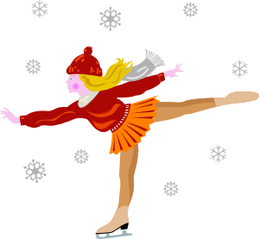

Winter

Slide 15
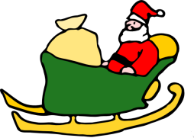

Write the letters in the correct order.
N a m w o n s
L l a b w o n s
E k a l f w o n s
S e t a k s e c I
Y r a u n a j
R e b m e c e d
T e r w i n

Slide 16
Write the letters in the correct order.
S n o w m a n
L l a b w o n s
E k a l f w o n s
S e t a k s e c I
Y r a u n a j
R e b m e c e d
T e r w i n

Slide 17
Write the letters in the correct order.
S n o w m a n
S n o w b a l l
E k a l f w o n s
S e t a k s e c I
Y r a u n a j
R e b m e c e d
T e r w i n

Slide 18
Write the letters in the correct order.
S n o w m a n
S n o w b a l l
S n o w f l a k e
S e t a k s e c I
Y r a u n a j
R e b m e c e d
T e r w i n

Slide 19
Write the letters in the correct order.
S n o w m a n
S n o w b a l l
S n o w f l a k e
I c e s k a t e
Y r a u n a j
R e b m e c e d
T e r w i n

Slide 20
Write the letters in the correct order.
S n o w m a n
S n o w b a l l
S n o w f l a k e
I c e s k a t e
J a n u a r y
R e b m e c e d
T e r w i n

Slide 21
Write the letters in the correct order.
S n o w m a n
S n o w b a l l
S n o w f l a k e
I c e s k a t e
J a n u a r y
D e c e m b e r
T e r w i n

Slide 22
Write the letters in the correct order.
S n o w m a n
S n o w b a l l
S n o w f l a k e
I c e s k a t e
J a n u a r y
D e c e m b e r
W i n t e r

Slide 23
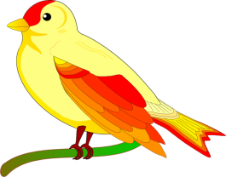



Spring

Slide 24






C
S
R
Guess the spring words
C
F
R

Slide 25


Write questions for the answers.
1) Yes, it’s windy today.
2) It’s cloudy and rainy.
3) Spring.

Slide 26
Write questions for the answers.
1) Is it windy today?
2) It’s cloudy and rainy.
3) Spring.

Slide 27
Write questions for the answers.
1) Is it windy today?
2) What’s the weather like today?
3) Spring.

Slide 28
Write questions for the answers.
1) Is it windy today?
2) What’s the weather like today?
3) What season is it?

Slide 29



Summer

Slide 30


Word groups
Find the odd one out.
1 autumn, spring, summer, weather
2 rainy, noisy, snowy, windy
3 beach, surfboard, snowflake, seaside
4 golden, brown, yellow, leaf

Slide 31
Word groups
Find the odd one out.
1 autumn, spring, summer, weather
2 rainy, noisy, snowy, windy
3 beach, surfboard, snowflake, seaside
4 golden, brown, yellow, leaf

Slide 32
Word groups
Find the odd one out.
1 autumn, spring, summer, weather
2 rainy, noisy, snowy, windy
3 beach, surfboard, snowflake, seaside
4 golden, brown, yellow, leaf

Slide 33
Word groups
Find the odd one out.
1 autumn, spring, summer, weather
2 rainy, noisy, snowy, windy
3 beach, surfboard, snowflake, seaside
4 golden, brown, yellow, leaf

Slide 34
Word groups
Find the odd one out.
1 autumn, spring, summer, weather
2 rainy, noisy, snowy, windy
3 beach, surfboard, snowflake, seaside
4 golden, brown, yellow, leaf

Slide 35




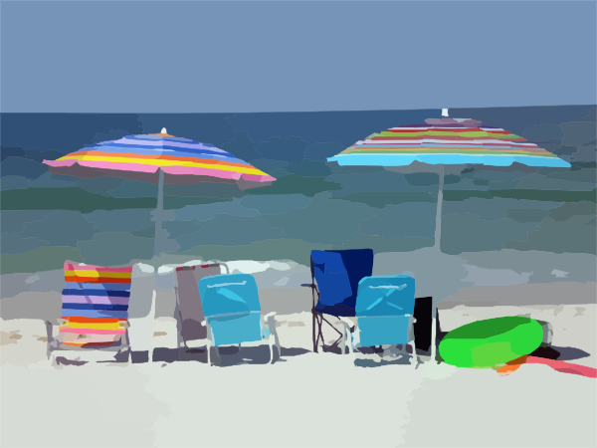

S
u
m
m
e
r

Slide 36

Используемая литература и интернет – ресурсы:
Учебное пособие:
Friends, Starter, Carol Skinner
http://pixelbrush.ru/
http://www.clker.com/

