Slide 1
appearance
внешность

Slide 2
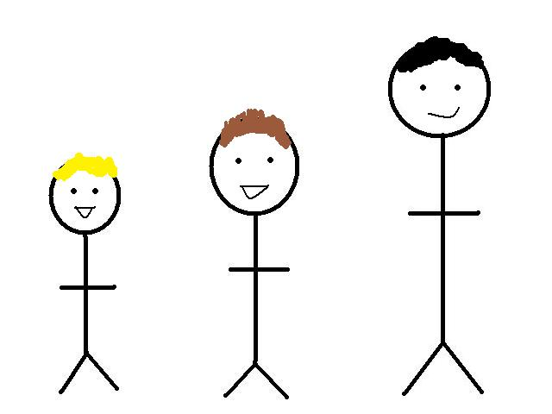
1
2
3
He is short.
He is medium height.
He is tall.

Slide 3
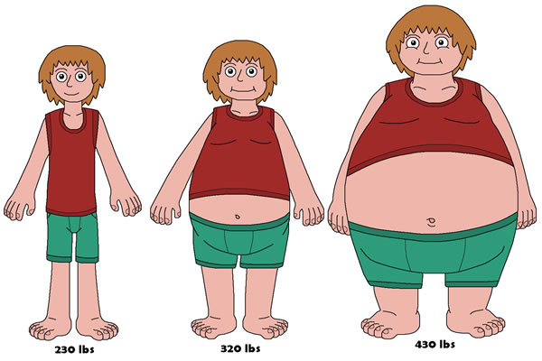
1
2
3
He is thin.
He is plump.
He is fat.

Slide 4
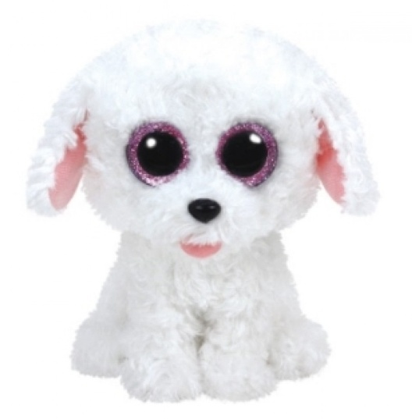

1
2
It has got big eyes.
It has got small eyes.

Slide 5
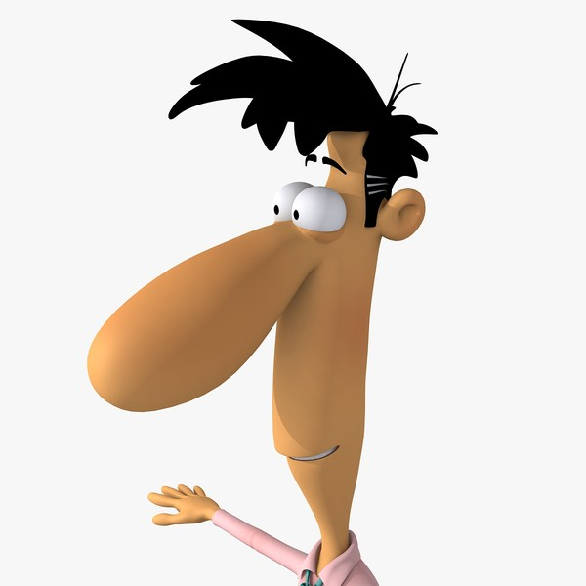
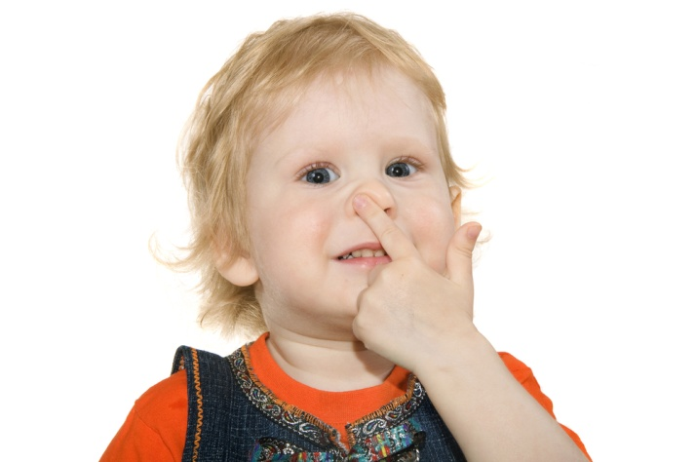
1
2
He has got a big nose.
He has got a small nose.

Slide 6
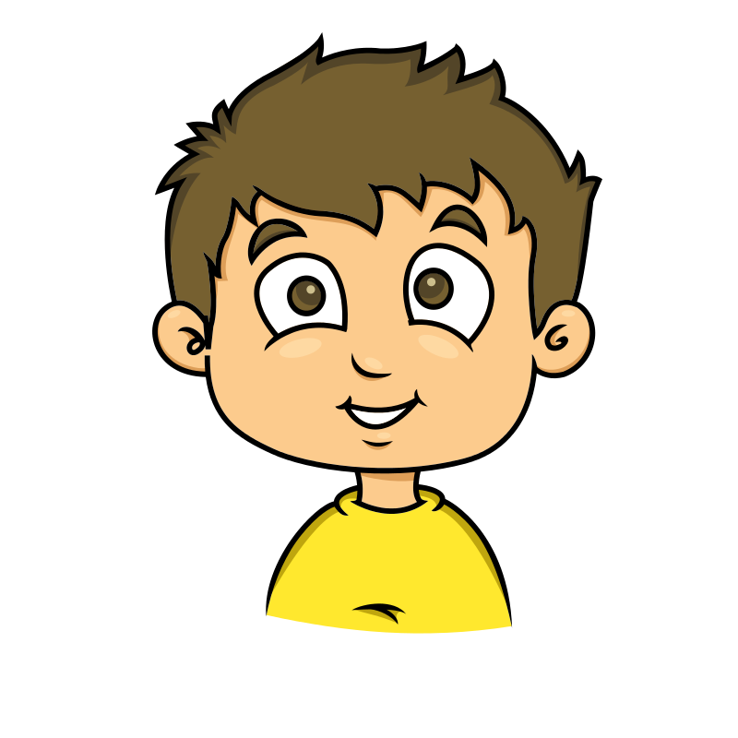

1
2
He has got a big mouth.
He has got a small mouth.

Slide 7
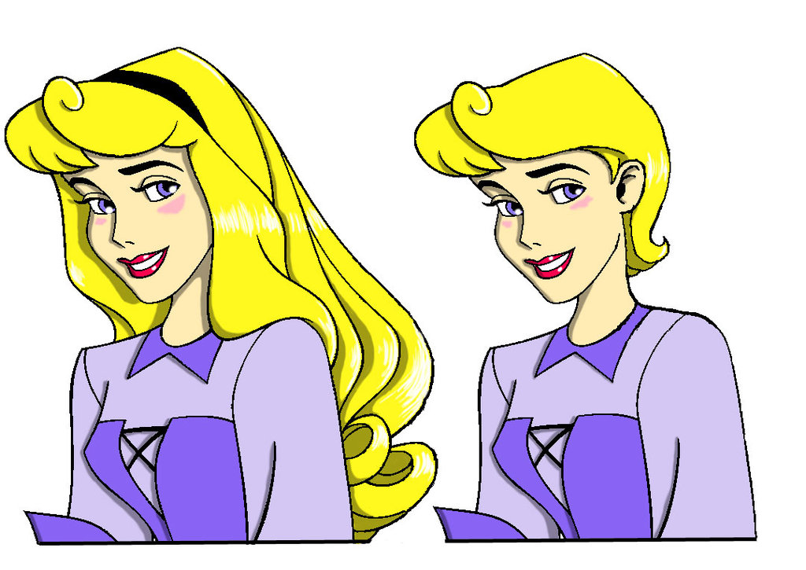
1
2
She has got long hair.
She has got short hair.

Slide 8
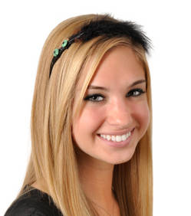
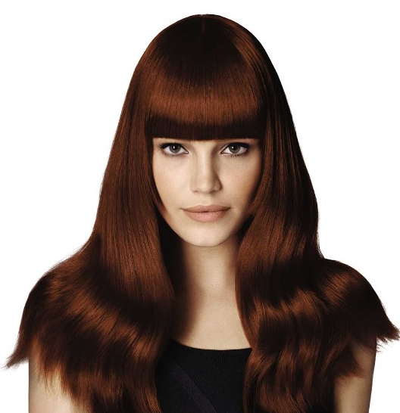
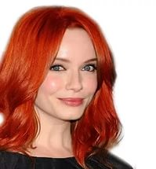
1
2
3
She has got fair hair.
She has got red hair.
She has got brown hair.

Slide 9
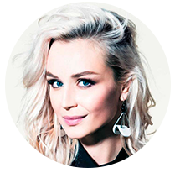
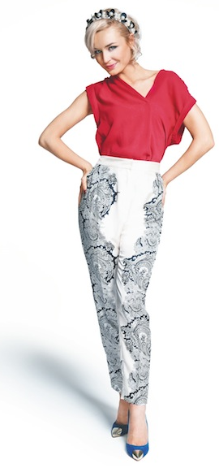
Полина Гагарина
She is tall and thin.
She has got long fair hair and big blue eyes.

