Slide 1

The Most Famous
Sights of the

Slide 2
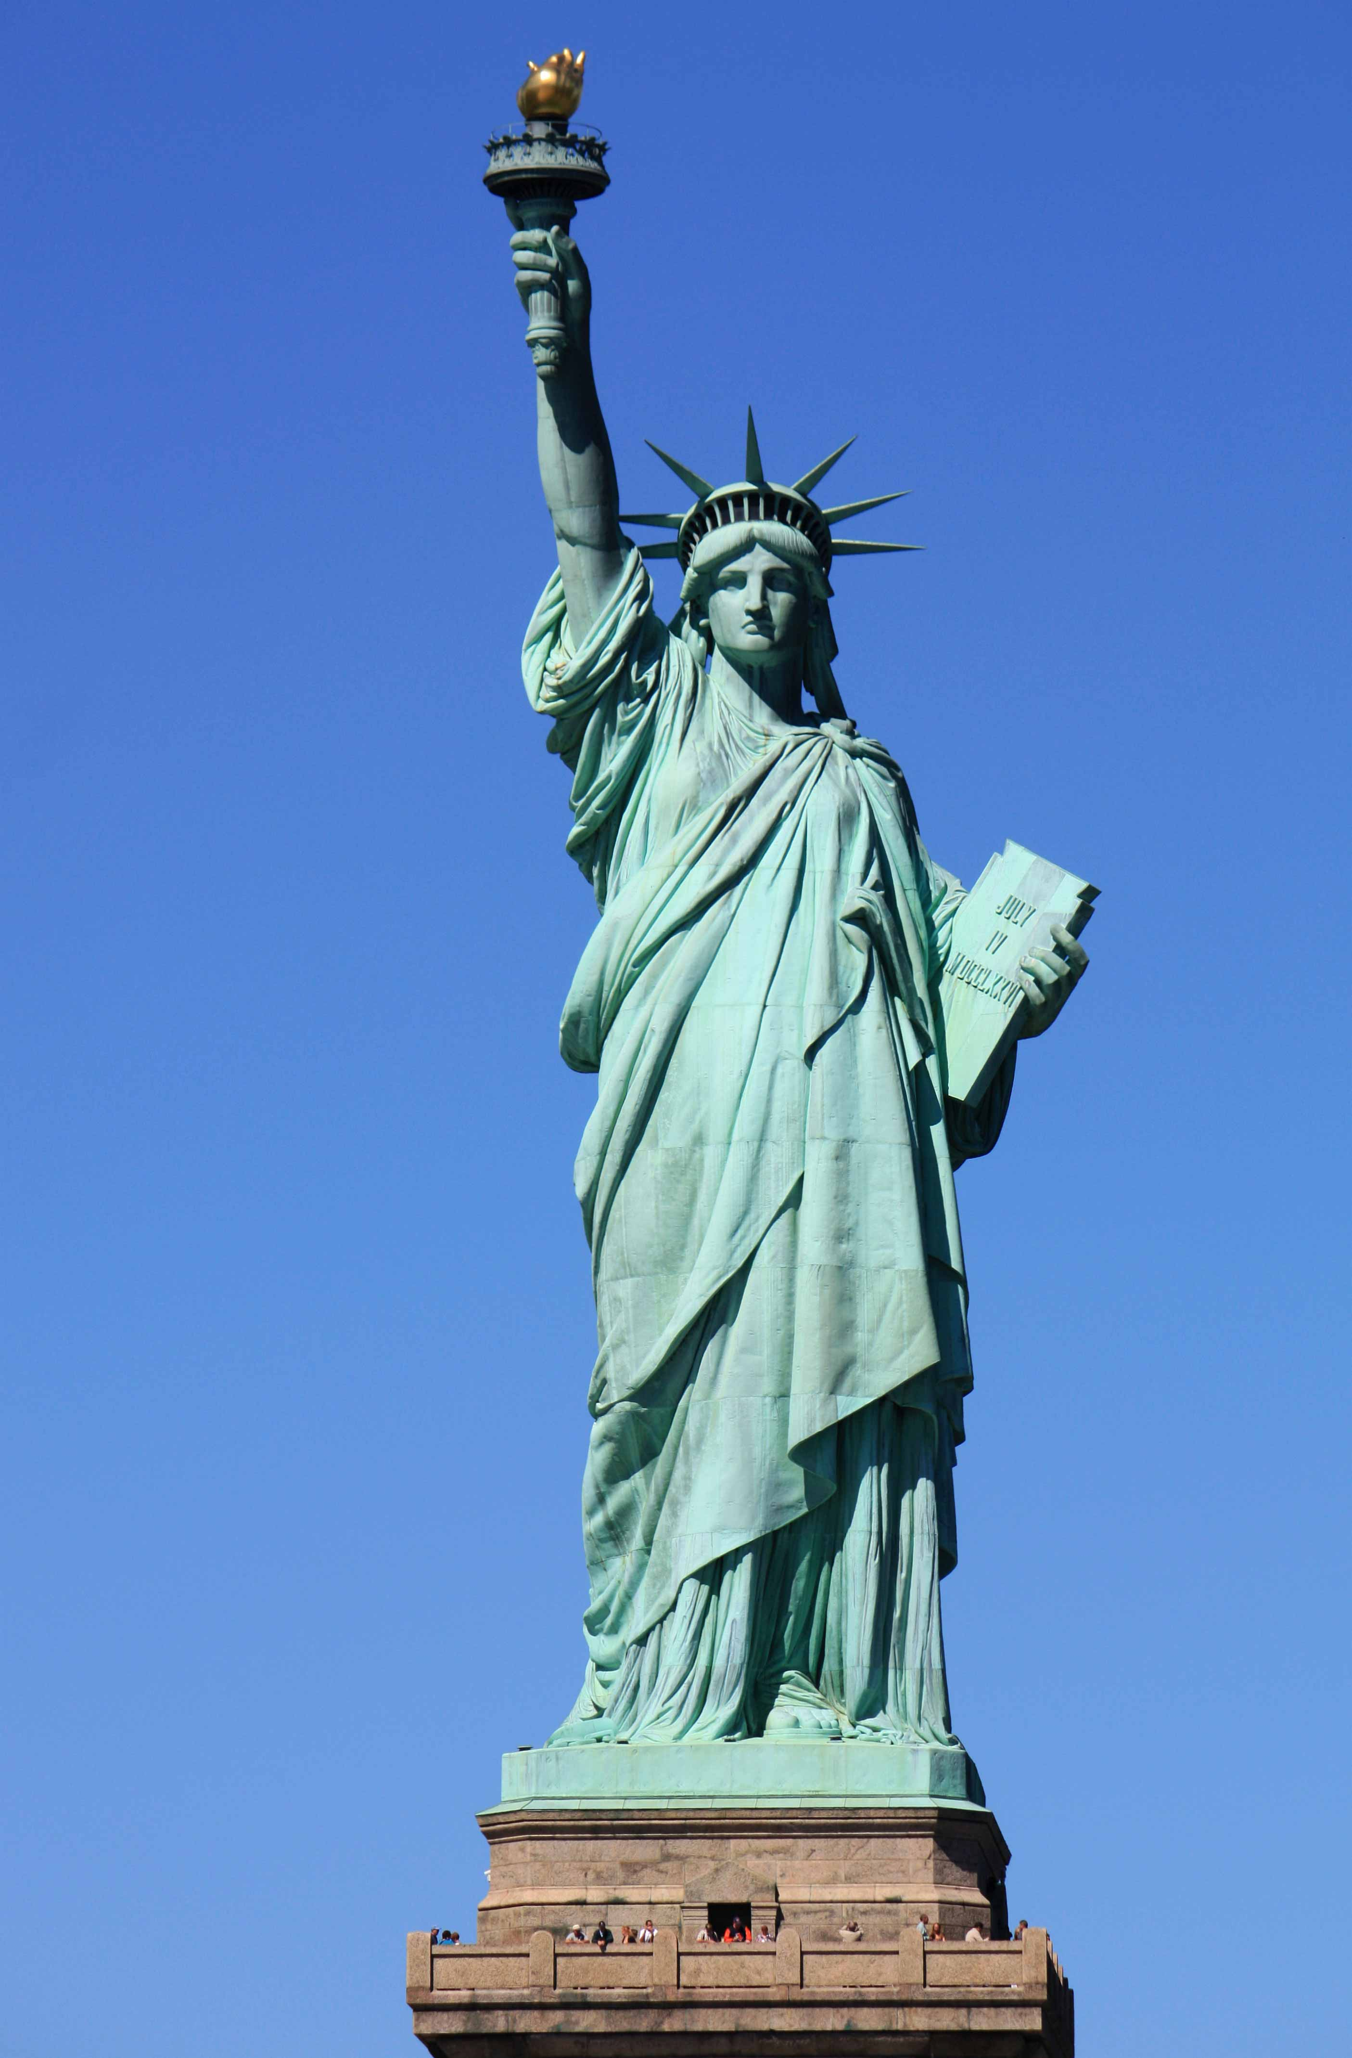
The Statue of Liberty

Slide 3
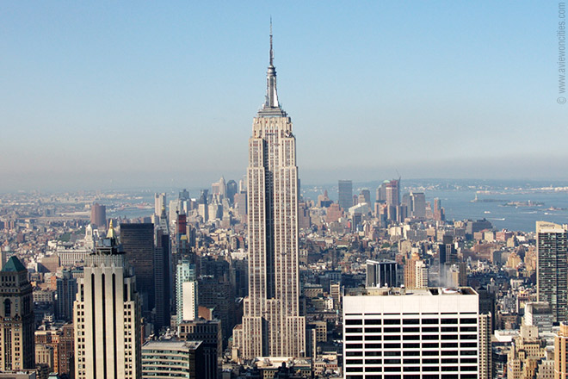
Empire State Building

Slide 4
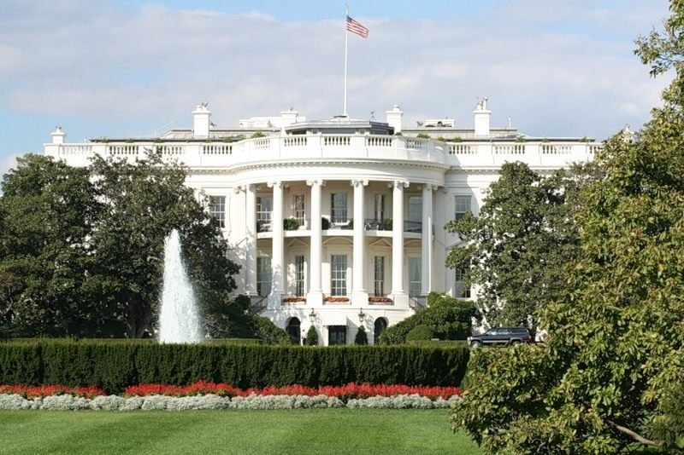
The White House

Slide 5
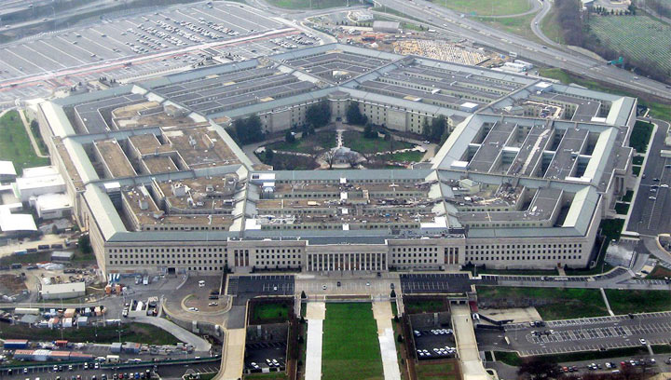
The Pentagon

Slide 6
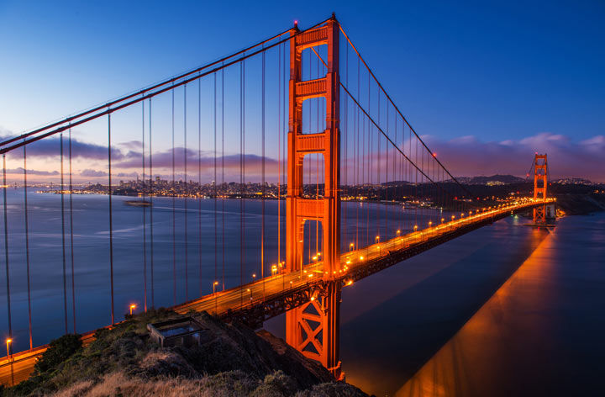
The Golden Gate Bridge

Slide 7
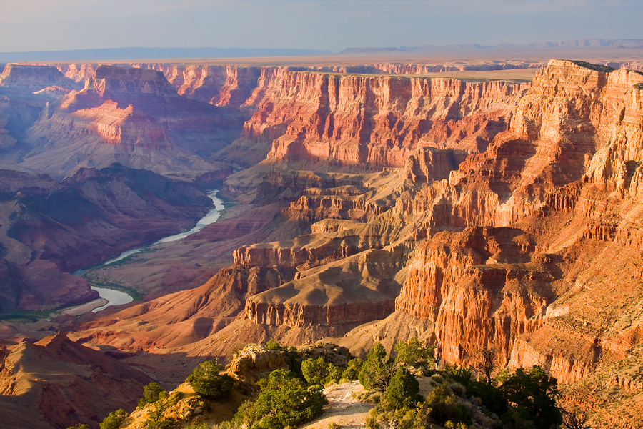
Grand Canyon National Park

Slide 8
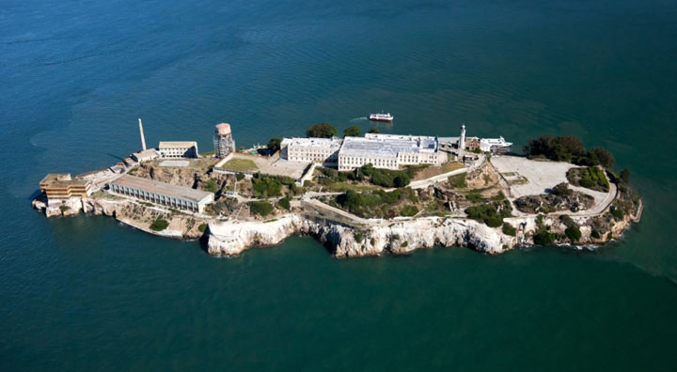
Alcatraz

Slide 9
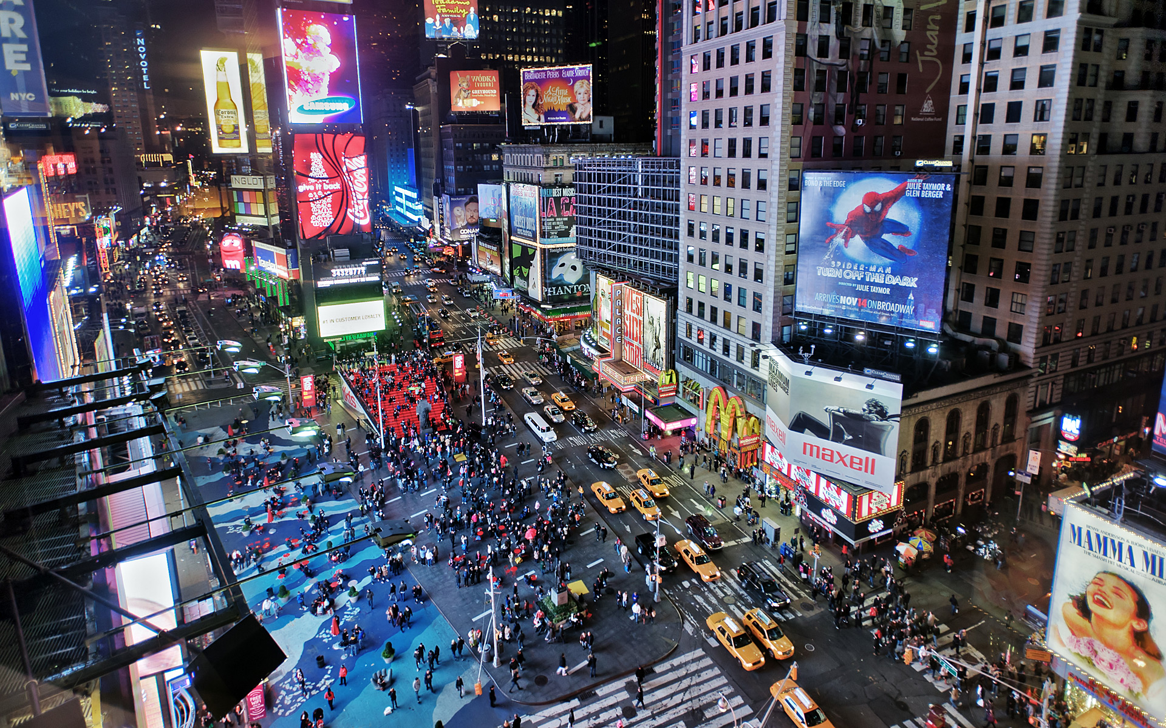
Times Square

Slide 10
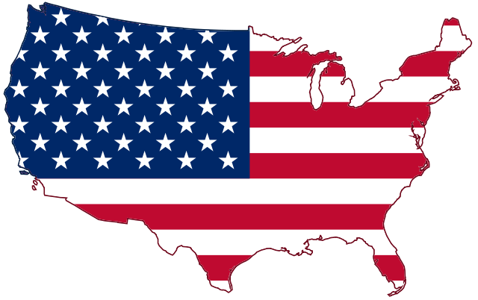
Thank you
for your attention!

