Slide 1
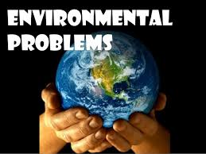

Slide 2
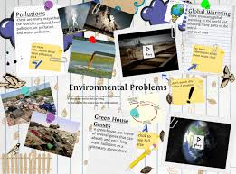

Slide 3
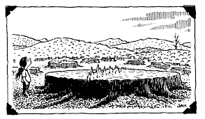
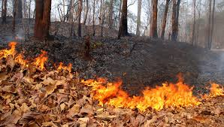

Slide 4
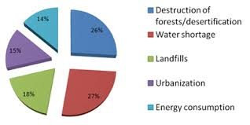
Population is not only limited to water, soil and nolse but has extended to light, visual, point and non point sources.

Slide 5
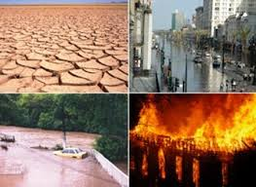

Slide 6
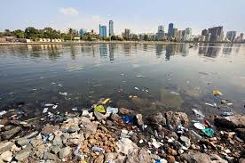
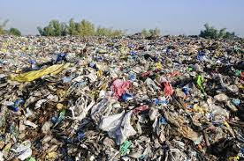
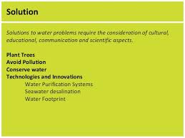

Slide 7
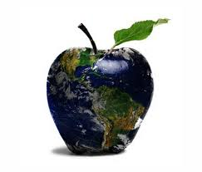
It is high time for human beings to right action towords saving the earth from major environmental issues. if ignored today, these ill effects are sure to curb human existence in the near future.

Slide 8
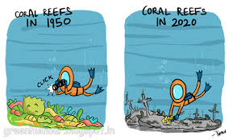
We should protect our world.

Slide 9

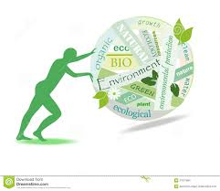
The green living movementent encorages people to live in a more are a number of dIfferent ways to “go green.”
environmentally friaedly way, and there

Slide 10

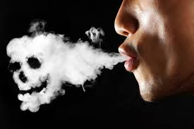


Slide 11

Some people say that we should invest money in ecology projects. While others bilive that nature is doing well by itself.

Slide 12
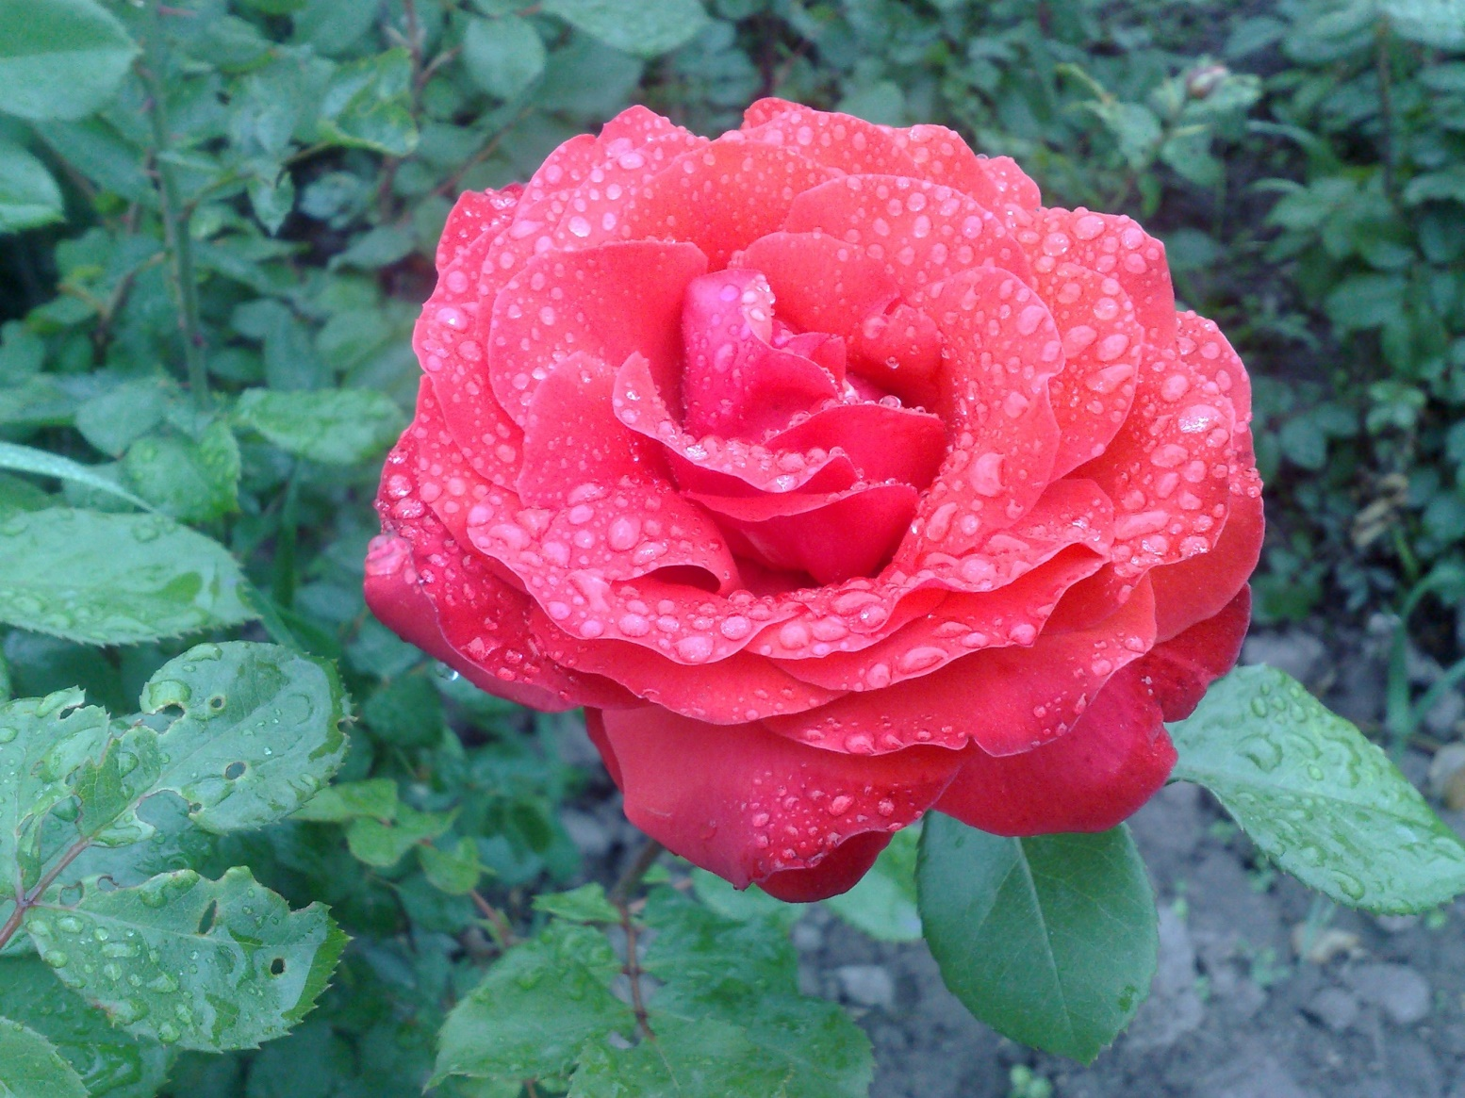
Thanks for attention!

