Slide 1
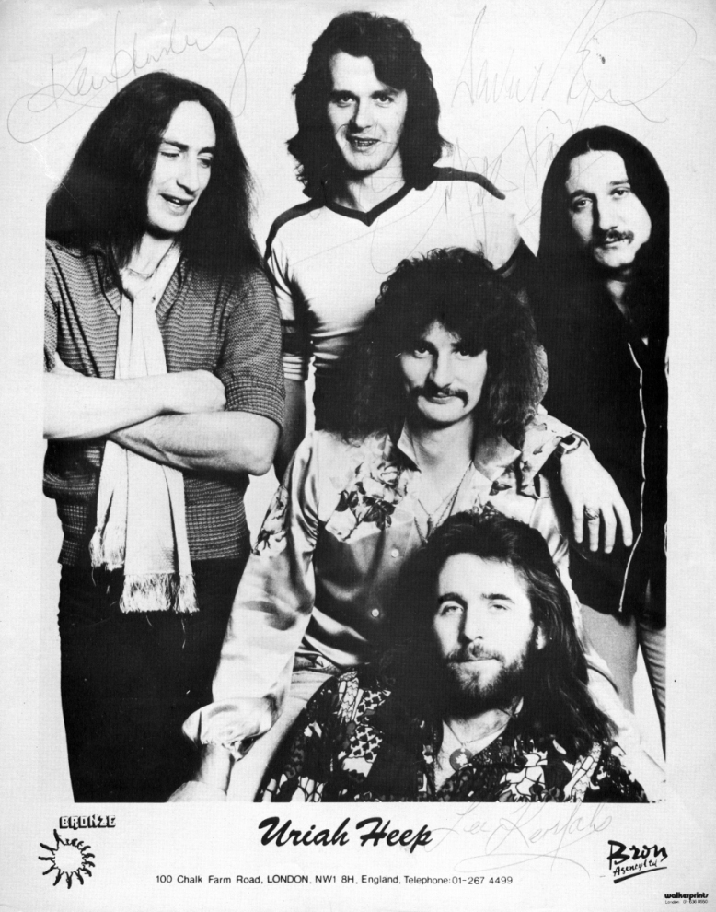
Uriah Heep

Slide 2

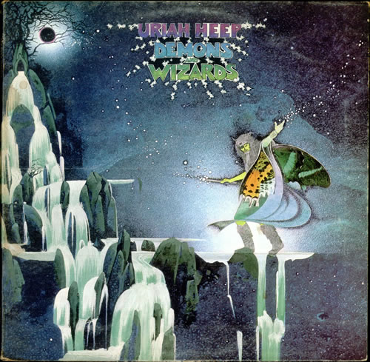
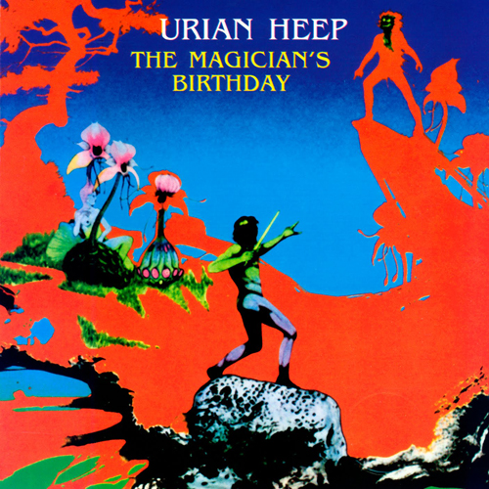
Uriah Heep -
British rock band, formed in 1969 in London. The world fame to the group brought in 1971-1973 years albums Look at Yourself, Demons and Wizards, and The Magician's Birthday, which are considered as classics of the rock.
1971
1972
1972

Slide 3

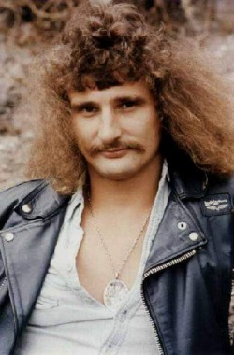
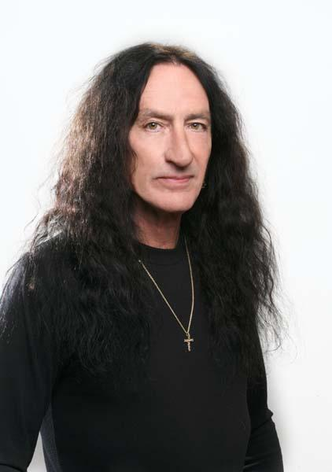

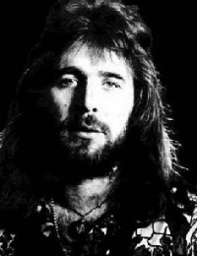
The Uriah Heep has changed several times, but the «classic» is considered to be quintet: Mick Box, David Byron, Ken Hensley, Gary Tane and Lee Kerslake.
Mick Box
David Byron
Ken Hensley
Gary Tane
Lee Kerslake
lead guitars
lead vocals
keyboards, guitars
bass
drums, percussion

Slide 4



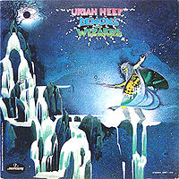

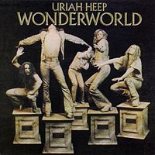
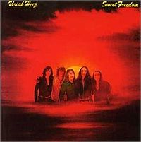





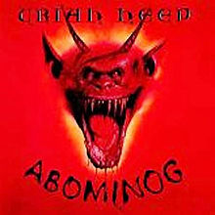

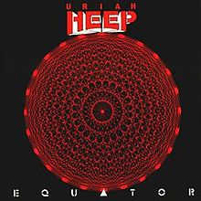


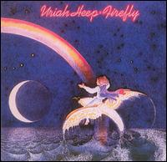
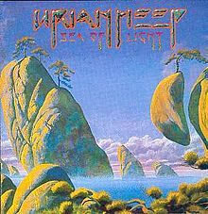


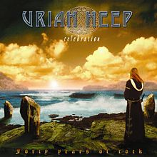

Discography. Studio albums

Slide 5




Discography. Live albums

Slide 6
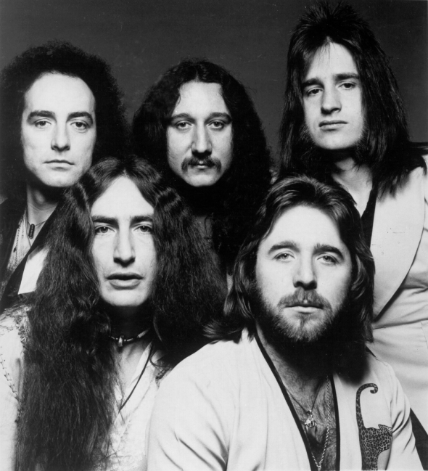
Hits:
Come away Melinda
Lady in Black
July morning
A year or a day
Wonderworld
Sweet Freedom
Return to fantasy
Why did you go
Love or nothing
Question
Kiss of freedom

