Slide 1
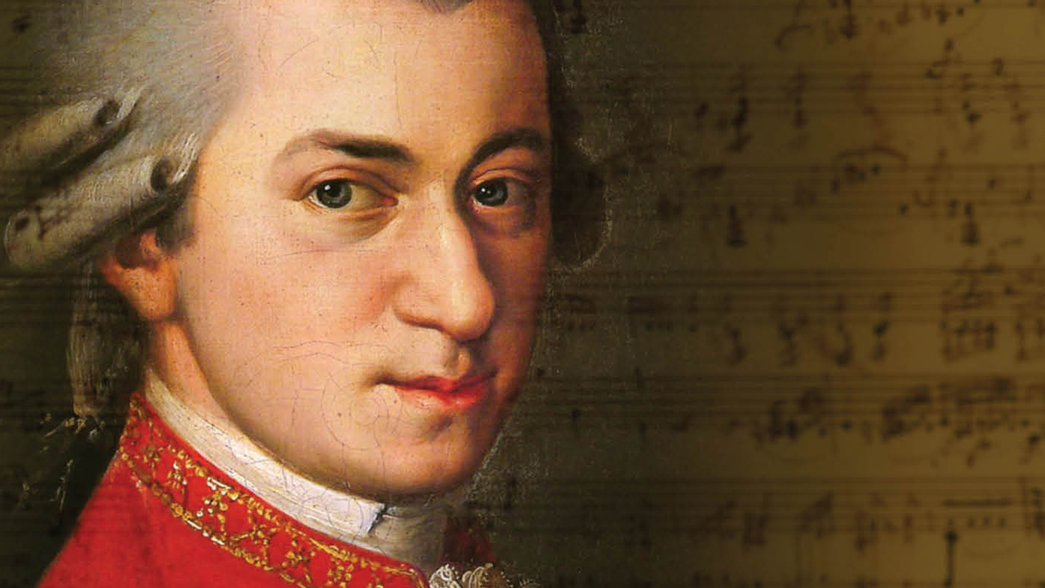
My friends called me just Wolfgang,
but for you I am…
Wolfgang Amadeus Mozart!

Slide 2
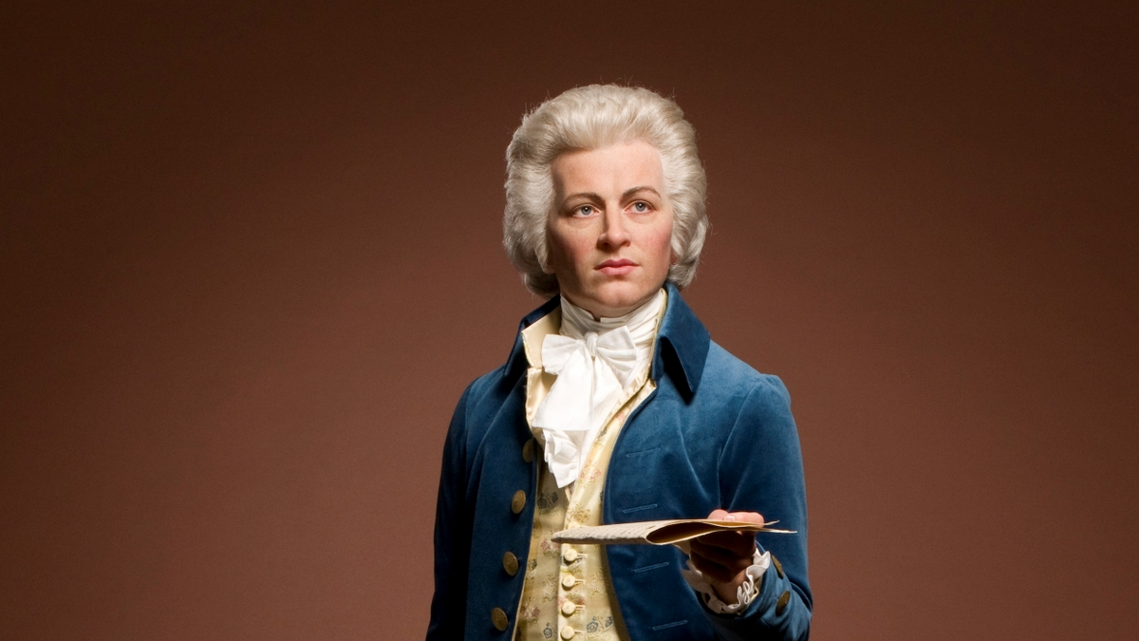
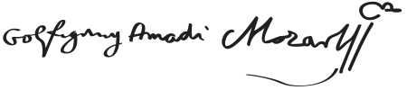
Wolfgang Amadeus Mozart
Born: January 27, 1756 Salzburg, Austria
Died: December 5, 1791 Vienna, Austria
Cause of death: Uncertain
Resting place: Vienna
Nationality: Austrian
Occupation: Composer, instrumentalist, music
Notable works: The Magic Flute Symphony in C major ("Jupiter"), The Marriage of Figaro, Piano Concerto in D minor
Style: Classical
Spouse: Constance Weber
Children: 2 sons
Parents: Leopold and Anna Maria Mozart
Signature:

Slide 3
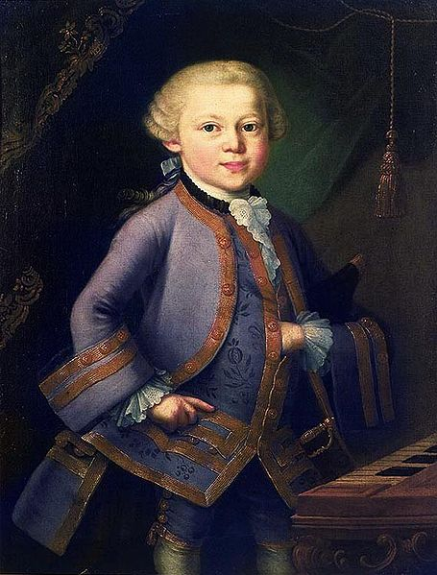
We didn’t have cameras those days, so catch my portrait.
Actually, it wasn’t for the poor to have personal portraits. Although, my parents weren’t rich.
So why did I have an own picture as a child?

Slide 4
…because I am a
GENIUS!
Just listen to some of my works and say what emotions could I feel creating them.

Slide 5
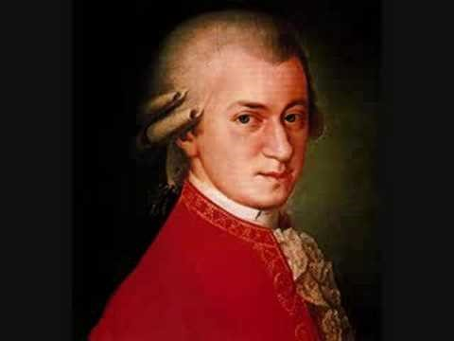
Symphony #40 in G minor

Slide 6
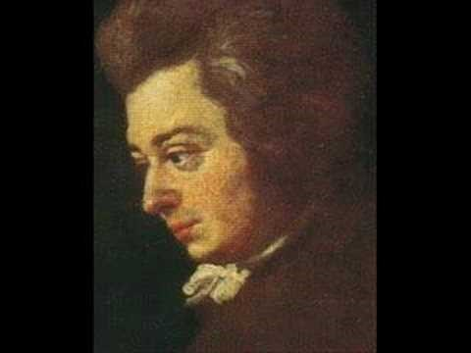
Eine Kleine Nachtmusik

Slide 7
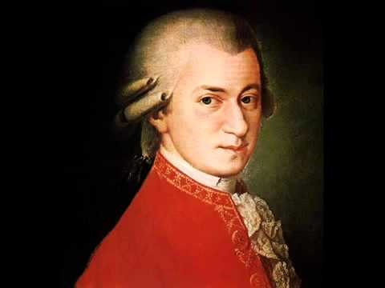
Sonata #8 in A minor

Slide 8
Now let’s read the text (ex.12, p.11) about me and do a ‘True-False’ task. Then we’ll check your thoughts about my works.

