Slide 1
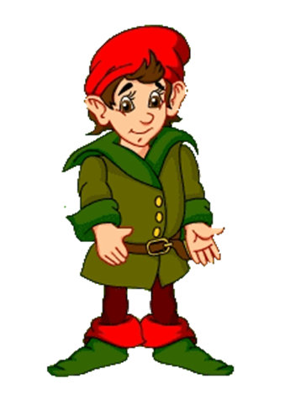
Открытый урок по английскому языку в 3 “Г" классе на тему:
Tiny’s daily routine
Учитель английского языка Садиева Д.А.
ГБОУ СОШ № 348

Slide 2
The 28th of April
Tuesday

Slide 3
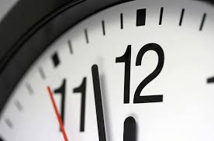
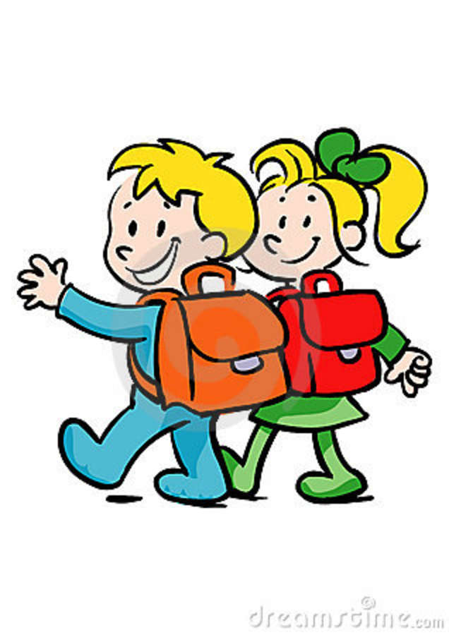
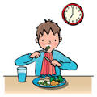

Slide 4
Today we will talk about:
1. Your daily routine;
2. the Time;
3. Tiny’s daily routine.

Slide 5
The Plan:
1. Greeting
2. The aim
3. Phonetics
4. Speaking (translate the words)
5. A game
6. Dialogues
7. A break
8.What’s the time
9. Poems/ a performance
10. Listening
11. Reading
12. Homework
13. A song
14. The results

Slide 6
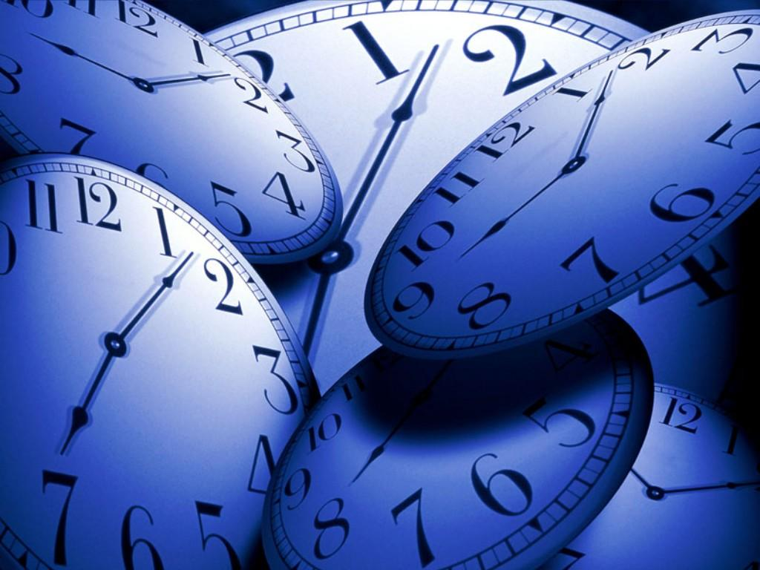
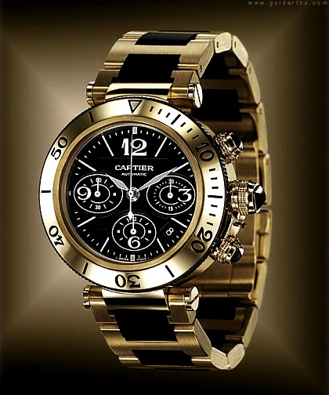
Tongue-twisters
1. “Tick”, the clock says “Tick, tick, tick What you have to do, do quick!”
2. Which wristwatches are Swiss wristwatches?

Slide 7
A game “It’s false”
1. You get up at 12 o’clock.
2. You have breakfast at five o’clock in the evening.
3. You have lunch at 8 am.
4. You clean your teeth and wash your face at 2 o’clock.
5. You go to school at 10.30.
6. You go to bed at 6 pm.

Slide 8
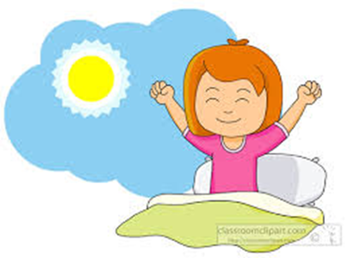
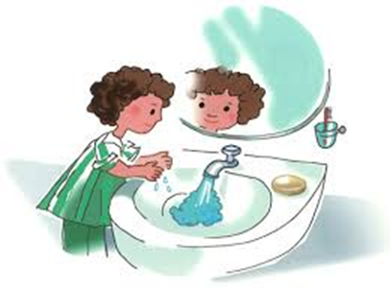
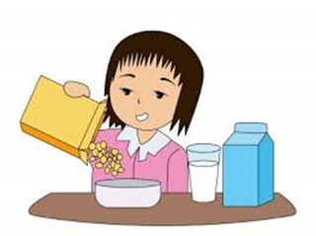

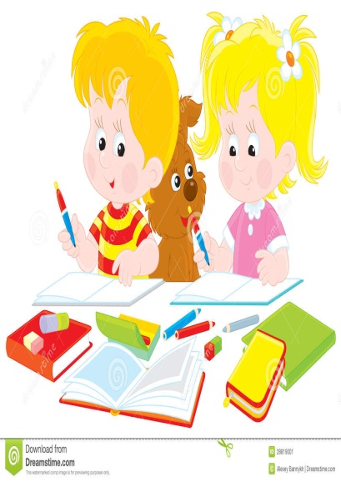
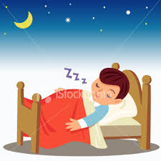

Your daily life
1.When do you usually get up?
2. When do you usually have breakfast?
3. When do you usually go to school?
4. When do you come home?
5. When do you usually have lunch?
6. When do you usually have dinner?
7. When do you go to bed?

Slide 9
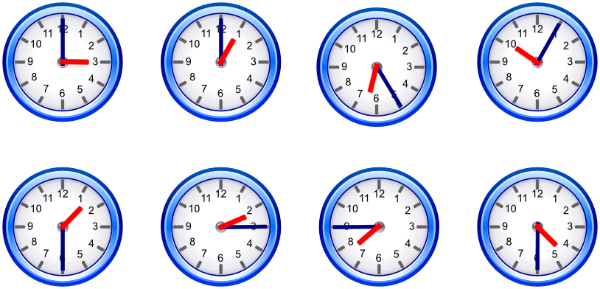
What time is it?
It is ….

Slide 10
Having a rest
Up, down, up, down,
(поднимаем руки вверх и вниз.)
Which is the way
Разводим руки в стороны.)
To London town?
Where? Where? Up in the air
(смотрим по сторонам.)
Close your eyes
(закрываем глаза.)
And you are there!
(открываем глаза.)

Slide 11
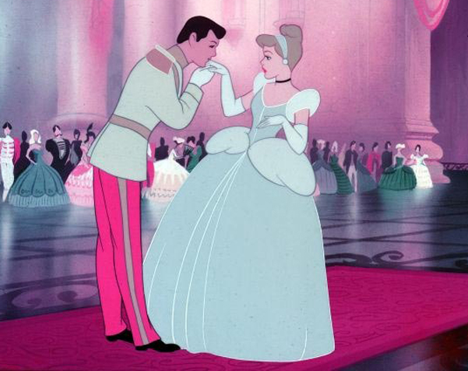
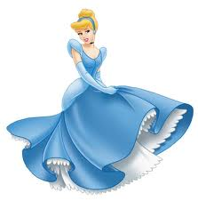
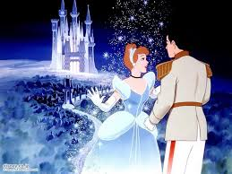
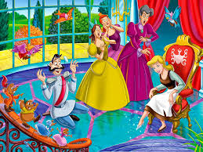

Slide 12

Listen and find the right answers.
1) Who lives in a fairytale forest?
No, he isn’t. He often plays jokes.
2) Does Tiny like ice cream?
He likes to ride his scooter.
3) What does he like to do?
Yes, he does. He has a sweet tooth.
4) Is he sad?
Tiny does.

Slide 13
Check your answers.
1) Who lives in a fairytale forest?
2) Does Tiny like ice cream?
3) What does he like to do?
4) Is he sad?
Tiny does.
Yes, he does. He has a sweet tooth.
He likes to ride his scooter.
No, he isn’t. He often plays jokes.

Slide 14
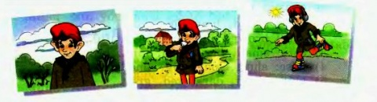
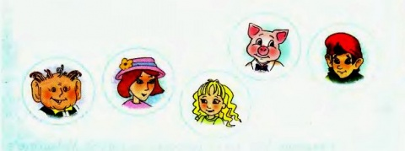
Textbook: Ex. 4page 112

Slide 15
Homework/ Workbook: page 70 Ex. 1-3. Textbook: Ex. 6, page 113

Slide 16
Let’s sing a song “The mulberry bush”
Here we go round the mulberry bush,
The mulberry bush, the mulberry bush,
Here we go round the mulberry bush,
Early in the morning.
This is the way we wash our face, Wash our face, wash our face, This is the way we wash our face
Early in the morning.
This is the way we brush our teeth, brush our teeth, brush our teeth,
This is the way we brush our teeth,
Early in the morning.
This is the way we comb our hair, comb our hair, comb our hair,
This is the way we comb our hair, Early in the morning.
This is the way we go to school, Go to school, go to school,
This is the way we go to school,
Early in the morning.

Slide 17
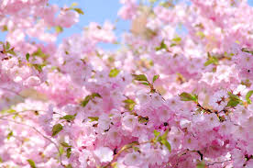
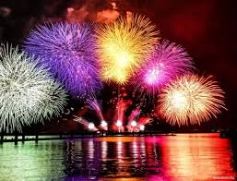
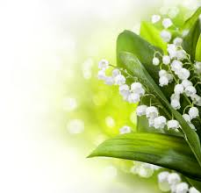
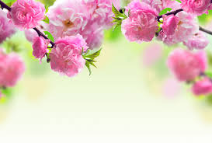
Thank you for your work!
You are clever pupils!

