Slide 1
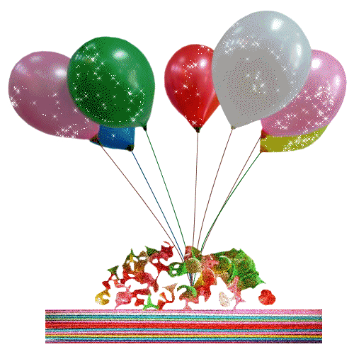
BIRTHDAY PARTY
.

Slide 2
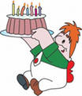
Invitation
Предполагаемый ответ:
Birthday Party Plan
Date: Friday, 22nd January
Time: 8 pm
Number of people: 15
Food/Drinks: 3 large pizzas, 10 burgers, 1 packet of chocolate biscuit, 2 bottles of lemonade
Activities: dance, games

Slide 3
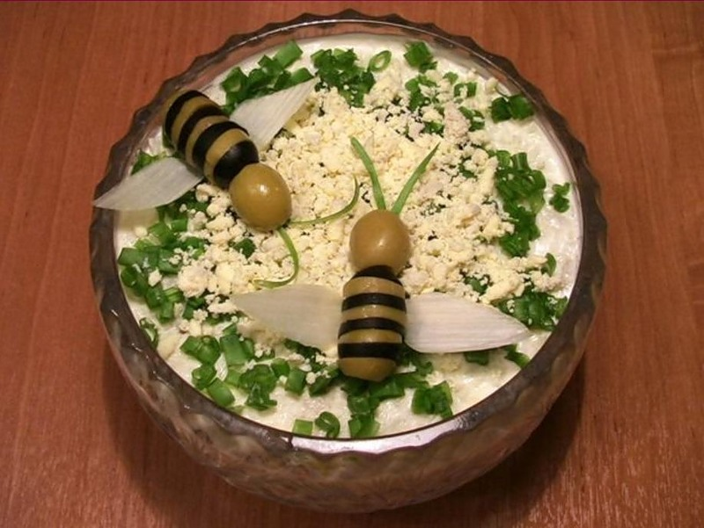
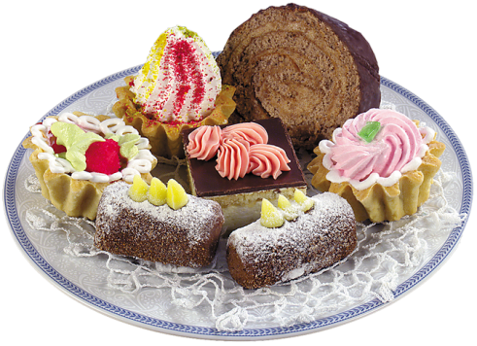
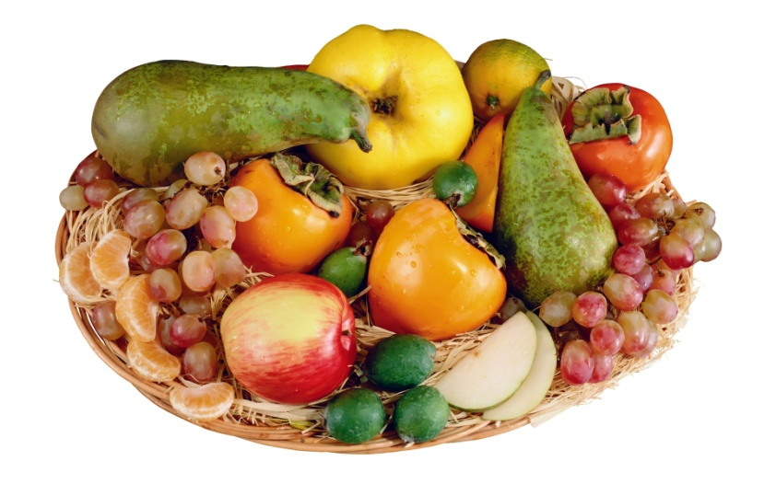
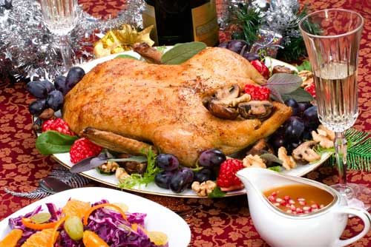
What’s your favourite food?

Slide 4
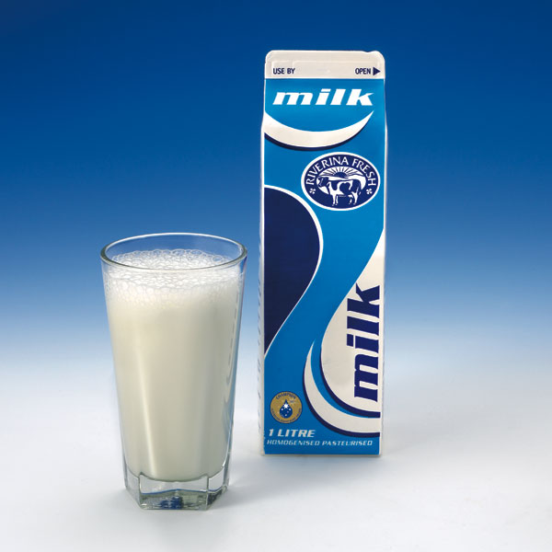
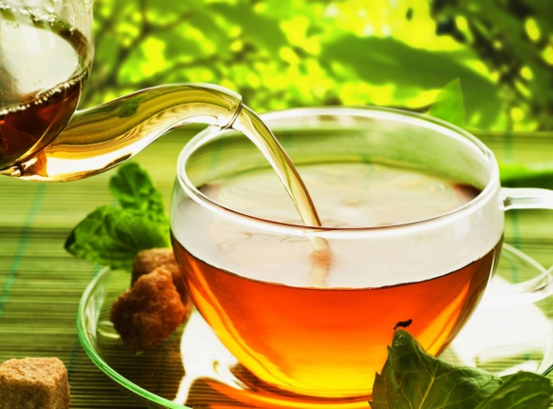
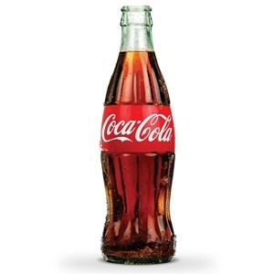
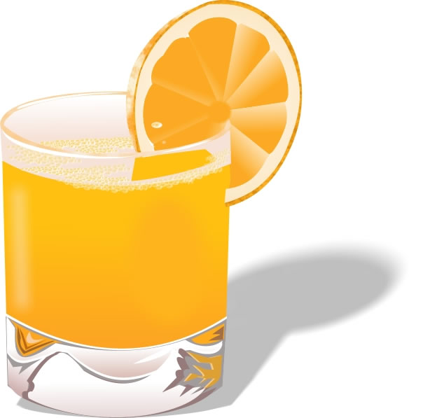
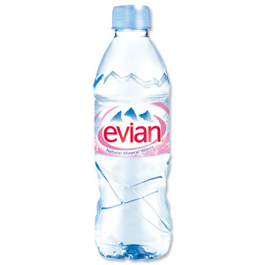
What do you usually drink?

Slide 5
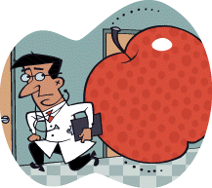
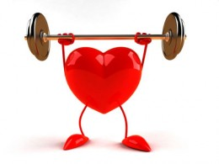
Read the proverbs and comment them.
An apple a day keeps doctor away.
Health is above wealth.

Slide 6
HEALTHY FOOD | NOT VERY HEALTHY FOOD
Fruit Apple Banana Vegetables tomato carrot grains | Pasta Hot dogs Bread chocolate Hamburger Cake Ice cream

Slide 7
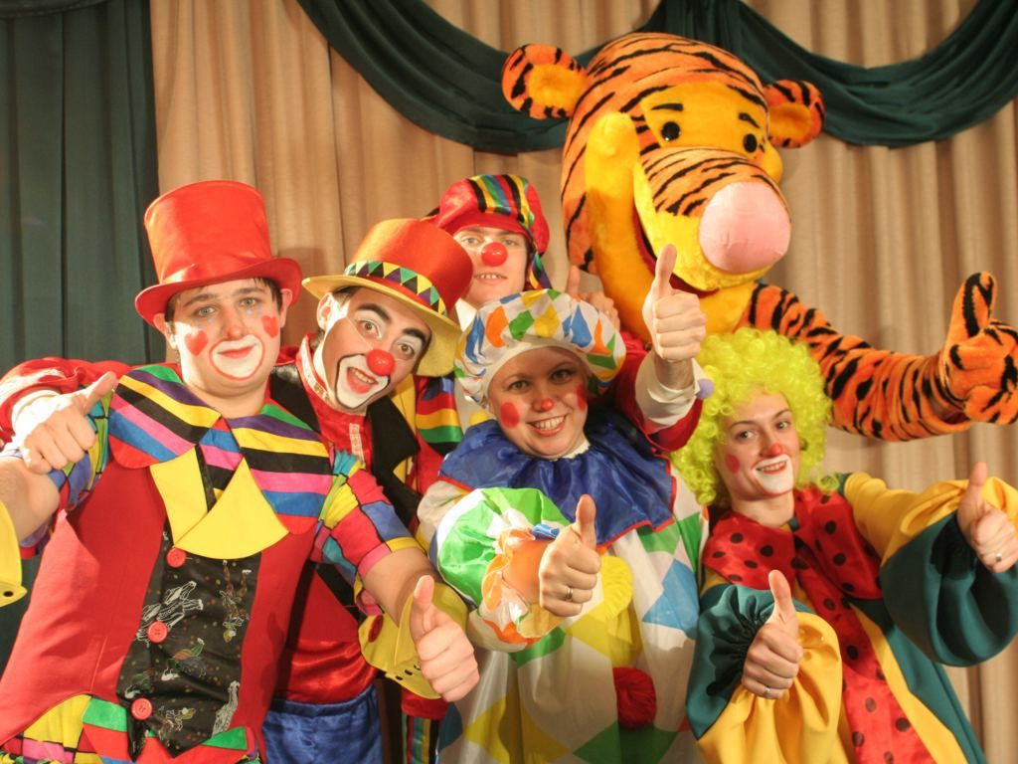

Let’s play!

Slide 8
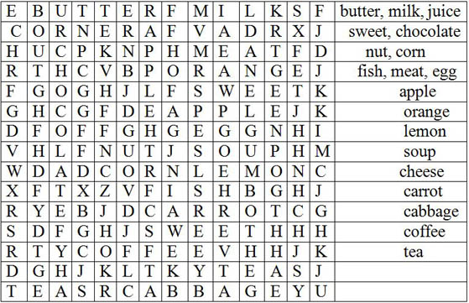

Slide 9
Правильный вариант
1.Much 1. Some
2.Many 2.Any
3.Much 3. Some
4.Much 4. Any
5.Many 5. Any

Slide 10
I. Whether the weather be fine,
or whether the weather be not.
Whether the weather be cold,
or whether the weather be hot.
We'll weather the weather
whether we like it or not.
II. Can you can a can as a canner can can a can?
Сможешь ли ты законсервировать консервы так, как может законсервировать консервы работник консервного завода?

Slide 11
“I can read”.
In Great Britain most people celebrate their birthdays on the day of the month they were born. Birthdays are celebrated with family and friends. People send invitations for the party. A birthday cake with candles is served. We have a table full of food, crisps, sandwiches, chocolates biscuits, ice cream and small sausages. We eat grapes, bananas and drink Coke and juice.
We decorate the house with balloons and play party games with my friends.
It is traditional to bring or send birthday cards and gifts to the birthday person. Many people send flowers. Other presents can be clothing, books, toys or CDs. Parties for children are usually celebrated at home. At children`s parties, children wear birthday hats and get souvenirs from the birthday child.

Slide 12
Special days
Decorations
Healthy food
Junk food
Favorite food
Activities
Gifts

Slide 13
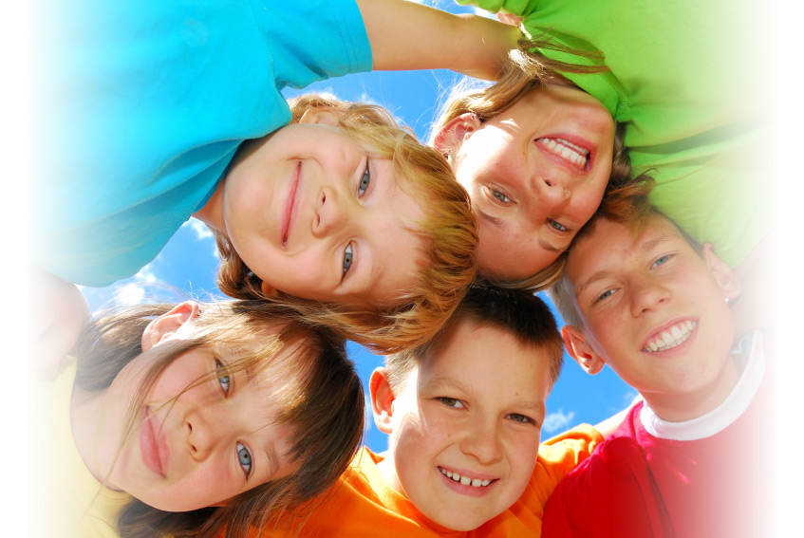
You are clever !

Slide 14
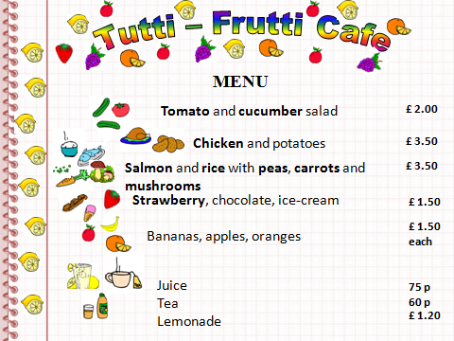

Slide 15
